Slide 1
Data Mining & Statistics
Session 7: Recommendation Systems
Haarlem
Peter Stikker

Slide 2
Course Overview
Session 1: Python Basics
Session 2: Python and Data
Session 3: Statistics
Session 4: Regression
Session 5: Classification
Session 6: Clustering
Session 7: Recommendation

Slide 3
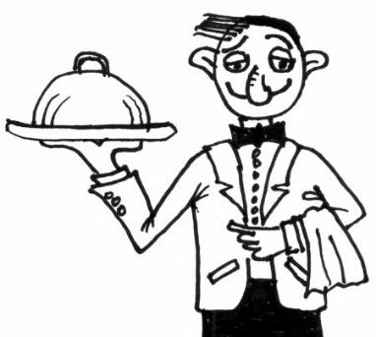
Menu for Today
Segment 1: Theory on Recommendation Systems
Segment 2: Live Demo of an Item Based Recommendation System
Closure
Notes:
Waiter picture by Unknown Author is licensed under CC BY-SA-NC

Slide 4
Segment 1
Recommendation Systems

Slide 5

Recommendation
Recommendation: “a suggestion that something is good or suitable for a particular purpose or job” (Cambridge Dictionary, n.d)
Recommender Systems: “software tools and techniques that provide suggestions” (Gorakala & Usuelli, 2015, p. 1)
Notes:
-----------------------------
Reference
Gorakala, S.K., & Usuelli, M. (2015). Building a Recommendation System with R. Packt Publishing: Birmingham, UK
https://dictionary.cambridge.org/dictionary/english/recommendation

Slide 6
Recommender Systems
Recommender Systems
Content Based
Filtering
Collaborative
Filtering
Hybrid
Filtering
Model Based
Memory Based
User Based
Item Based
(adapted from Hrnjica, Music, & Softic, 2020, p. 128)
Notes:
-------------------------------------------------
References
Hrnjica, B., Music, D., & Softic, S. (2020). Model-based recommender systems. In F. Al-Turjman (Ed.), Trends in cloud-based IoT (pp. 125–146). Springer.

Slide 7
Content vs. Collaborative
Content Based Filtering focusess on a single user and compares his/her preferences with the various items and their attributes.
Collaborative Filtering focusses on multiple users and compares them with each other and the various items.

Slide 8








Content vs. Collaborative Example
A user has liked seasons 1 to 7 of the series Game of Thrones.
Now season 8 comes out….
Content Based Suggestion
Very similar attributes to previous liked seasons (actors, genre, producer, etc.) so: Yes recommend.
Collaborative Based Suggestion:
Well at first not possible (no one has seen it at launch) but after a while we notice other users who also liked season 1-7 don’t like season 8, so Not recommended.

Slide 9
Recommender Systems
Recommender Systems
Content Based
Filtering
Collaborative
Filtering
Hybrid
Filtering
Model Based
Memory Based
User Based
Item Based
(adapted from Hrnjica, Music, & Softic, 2020, p. 128)
Notes:
-------------------------------------------------
References
Hrnjica, B., Music, D., & Softic, S. (2020). Model-based recommender systems. In F. Al-Turjman (Ed.), Trends in cloud-based IoT (pp. 125–146). Springer.

Slide 10
Model vs. Memory
Memory Based
Uses all the available data. For each new user, everything has to be re-calculated.
Model Based
Model the current data, then use this for the predictions/recommendations.

Slide 11
Recommender Systems
Recommender Systems
Content Based
Filtering
Collaborative
Filtering
Hybrid
Filtering
Model Based
Memory Based
User Based
Item Based
(adapted from Hrnjica, Music, & Softic, 2020, p. 128)
Notes:
-------------------------------------------------
References
Hrnjica, B., Music, D., & Softic, S. (2020). Model-based recommender systems. In F. Al-Turjman (Ed.), Trends in cloud-based IoT (pp. 125–146). Springer.

Slide 12




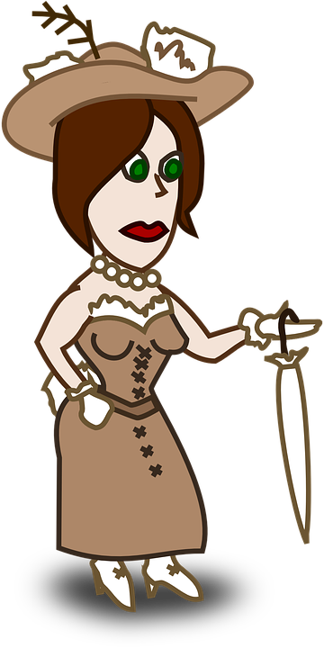







User vs. Item based
User Based
User 5 ratings most similar to user 3.
Suggest Negative
Item Based
Most users who liked Fruit also liked Cars
Suggest Positive

Slide 13
Item based Collaborative vs. Content Based
Item Based Collaborative looks at how other USERS have rated different items. Then looks at the similarities between different items.
Content Based looks at how items are similar based on different attributes. Then looks at the attributes of the single user.

Slide 14
Segment 2
Live Demo Item-Based Recommender

Slide 15
Live Demo
A Live Demo of a Recommender system.

Slide 16
Closure

Slide 17
H☺me W☹rk
DMS Assignment 4 (see Moodle)

Slide 18

Questions

